Slide 1
Motor Vehicle Crash Data in Texas (From 2013-2015)
Data Wrangling and Visualization Final Project
Amrita Guha

Slide 2
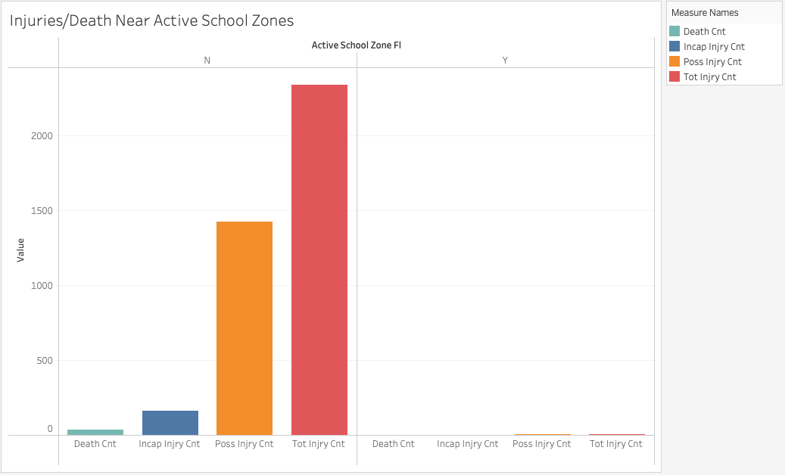
Were There Serious Crashes by Active School Zones?
Fortunately, there have not been serious motor vehicle crashes in active school zones in Texas from 2013 through 2015.
No one died from a motor vehicle crash in an active school zone, and a minimal number of people got injured.
In active school zones, the total injury count is 4. In contrast, outside of active school zones, the total injury count is 2,335.
People are probably more careful operating their motor vehicles in school zones and are more reckless outside of school zones.

Slide 3
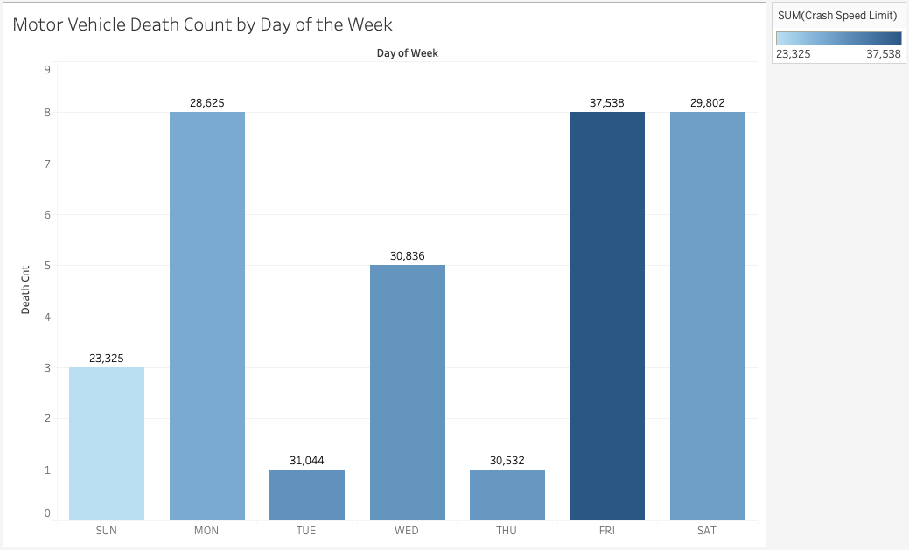
How do Death Counts Vary by Day of the Week?
The beginning of the workweek and the end of the workweek saw the most deaths from motor vehicle crashes; Monday, Friday and Saturday have the same death count.
Tuesdays and Thursdays had the lowest number of deaths by motor vehicle crash.
Interestingly, there were a lot more crashes on Tuesdays and Thursdays than on Sundays, Mondays and Saturdays but less people died.
The following three slides will analyze the most popular crash times for Mondays, Fridays and Saturdays to provide explanations for the high number of deaths on those days.

Slide 4
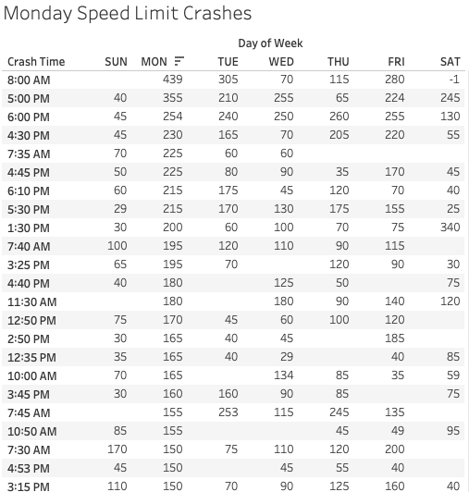
Most Popular Crash Times for Crashes by Speed Limit on Mondays
On Mondays, the most crashes where people were operating their motor vehicles at the speed limit happened at 8 AM. The second highest happened at 5 PM.
The data reflects that people get into accidents in the beginning and end of the workday on Mondays.
A possible explanation for the high number of crashes on Monday mornings is that people oversleep after getting used to “sleeping in” on the weekend, so they speed to get to work on time.
It could be that people get into accidents at 5 PM because they are rushing to get back home after the first day back at work after the weekend.

Slide 5
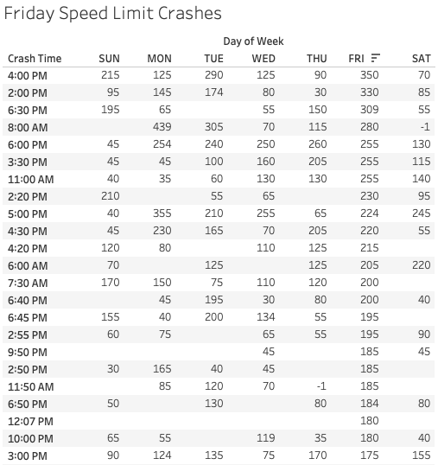
Most Popular Crash Times for Crashes by Speed Limit on Fridays
On Fridays, the most crashes by speed limit happened at 4 PM, followed by 2 PM.
There are also a significant number of crashes at 6:30 PM, which is a reasonable time for when people get out of work.
Perhaps people get out of work on Fridays and rush to get home for weekend plans to start.
There doesn’t seem to be as many crashes later in the night which could be surprising for those who believe that there is more drunk driving on Friday nights which would lead to more crashes
As for why so many crashes happened at 2 PM, it could be that students get out of school around this time and are also in a rush to get their weekends started.

Slide 6
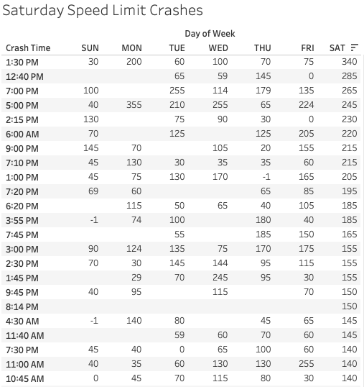
Most Popular Crash Times for Crashes by Speed Limit on Saturdays
On Saturdays, the highest number of crashes where drivers were driving at the speed limit were at 1:30 PM, followed by 12:40 PM.
The highest number of crashes happened in the middle of the day; this could be because there are more people out and about on a Saturday during the day
There were more crashes in the earlier part of the afternoon and the early evenings.
There were not as many crashes later in the night, which is also surprising for those who believe that there is more drunk driving on Saturday nights.

Slide 7
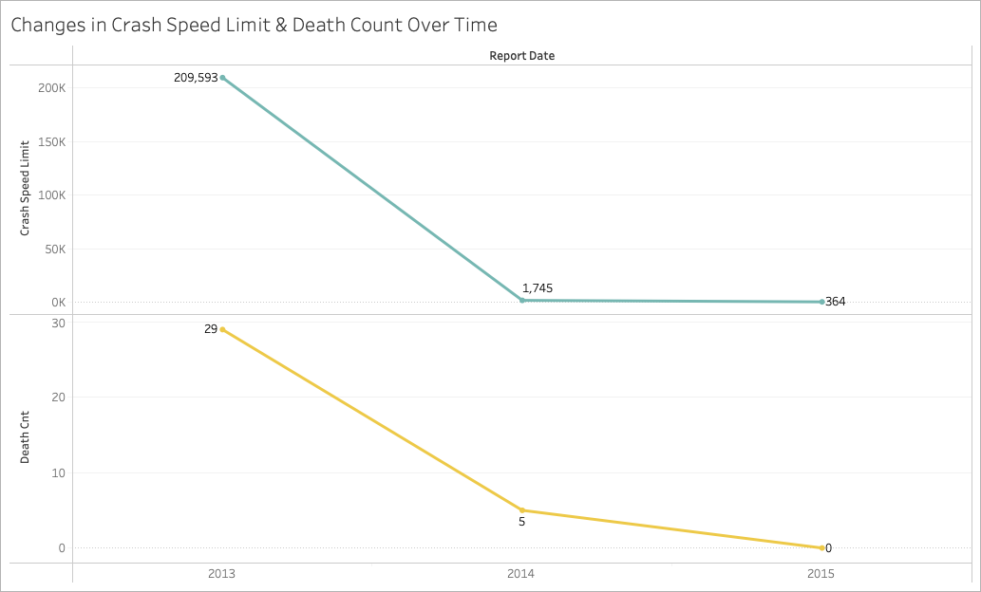
Is There a Correlation Between Speeding Accidents and Death Counts?
The trend lines for changes in crashes by the speed limit over time and changes in death count over time are both negative and extremely similar.
In both cases, there is a dramatic decrease from 2013 to 2014, and a far less dramatic decrease from 2014 to 2015.
The similarities indicate that the decrease in crashes by speed limit influenced the decrease in death count.
But to truly determine whether the two variables are correlated, a linear regression is necessary.

Slide 8
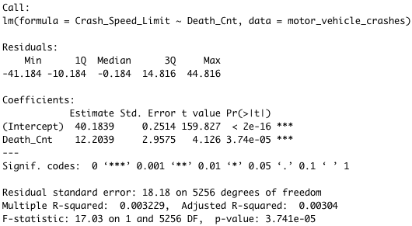

Linear Regression: Crashes by Speed Limit and Death Counts
COMMENTS ON THE LINEAR REGRESSION
The visual to the right was produced using R Studio; it depicts a linear regression between crashes by the speed limit over time and changes in death count over time.
The most important aspects of the visual on the right are the adjusted R-squared (which indicates how much of the data supports the correlation) and the p-value (which indicates the statistical significance of the model).
The adjusted R-squared is 0.00304 which 0.304% of the correlation is supported by the data. Since this percentage is extremely small, it is likely there is no correlation between the number of crashes by speed limit and the death count.
The p-value is far less than 0.05, which means that the model is not statistically significant.
We can say with 95% confidence that the two variables are not correlated.
CODE:

